Slide 1
ROBOT CAR
ROBOT PROGRAMMING

Slide 2
INTRODUCTION
A Robot car is any machine which is completely automatic, i.e. it starts on its own, decides its own way of work and stops on its own.

Slide 3
GOAL
The goal of project to build a line following and obstacle avoiding robot car that can work autonomously.

Slide 4

MOTIVATION
The line following and obstacle avoiding robot car is commonly used for:
Industrial Applications: These robots can be used as automated equipment carriers in industries replacing traditional conveyer belts.
Automobile applications: These robots can also be used as automatic cars running on roads with embedded magnets.
Domestic applications: These can also be used at homes for domestic purposes like floor cleaning etc.
Guidance applications: These can be used in public places like shopping malls, museums etc. to provide path guidance.

Slide 5
PROBLEMS & SOLUTIONS
1) How the robot will follow the line?
2) How to let a robot car avoid an obstacle during the line following?
1) Using infrared sensors!
2) Using an ultrasonic sensor to detect the obstacle and then circumnavigate it.

Slide 6
How it will work?
FLOW diagram
Start
No
Distance to object < 5cm
Yes
Follow the line
Avoid the obstacle
Then

Slide 7
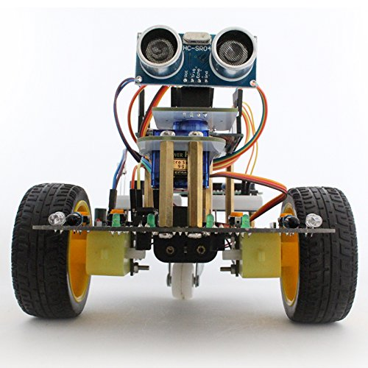
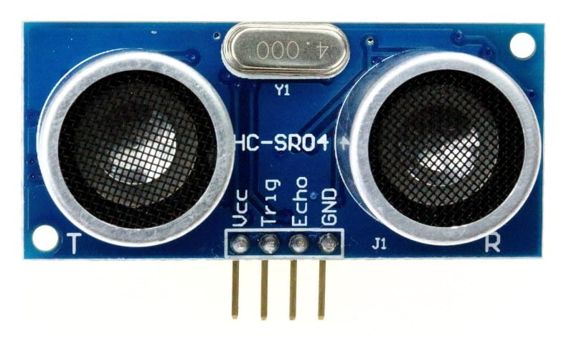
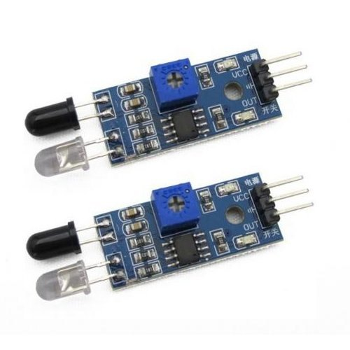
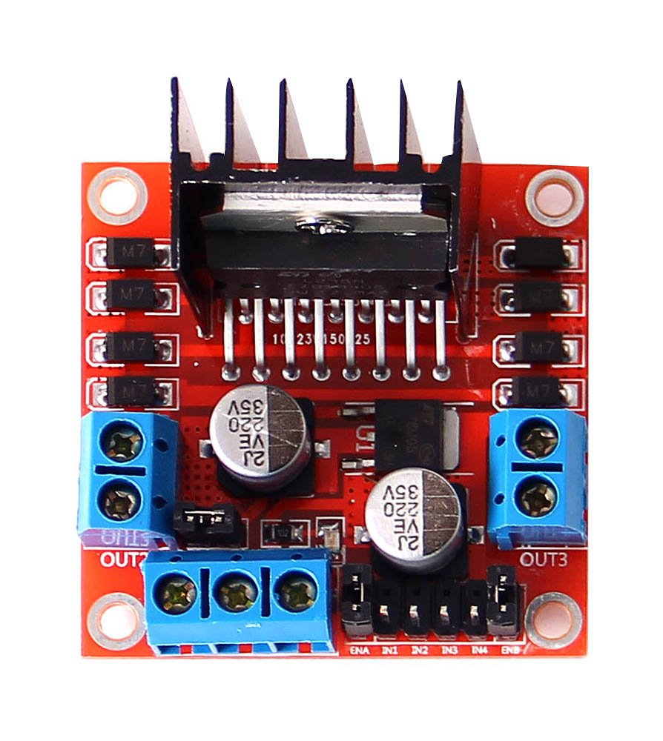
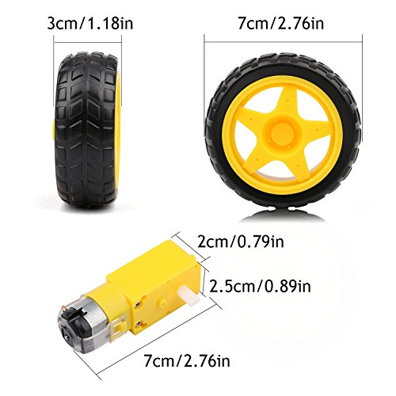
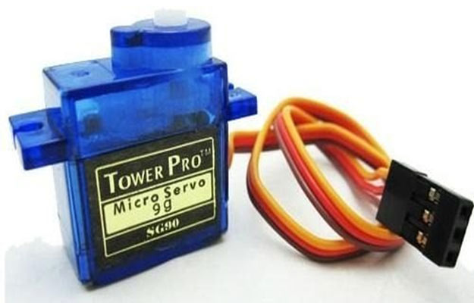
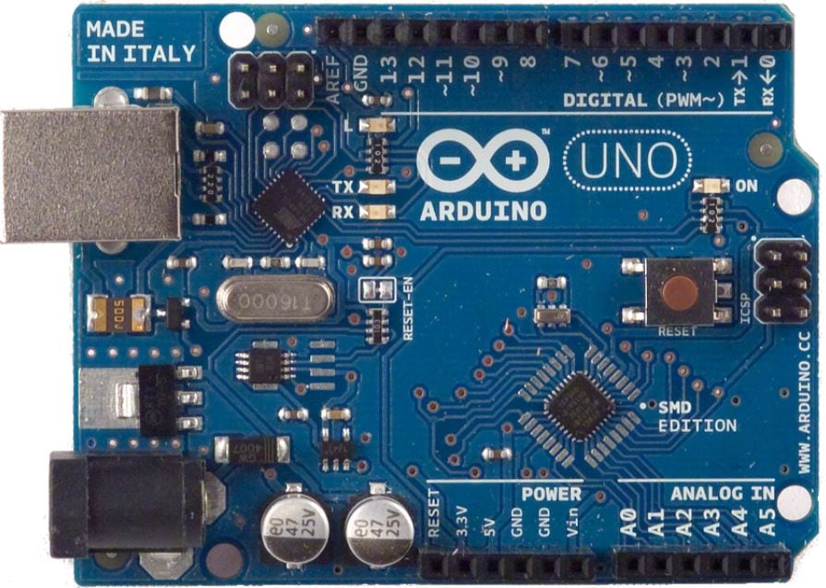
What we used?
Arduino Uno
Ultrasonic Sensor
Infrared sensors
Servo motor
Motor bridge
DC Motors
Battery
Wheels

Slide 8
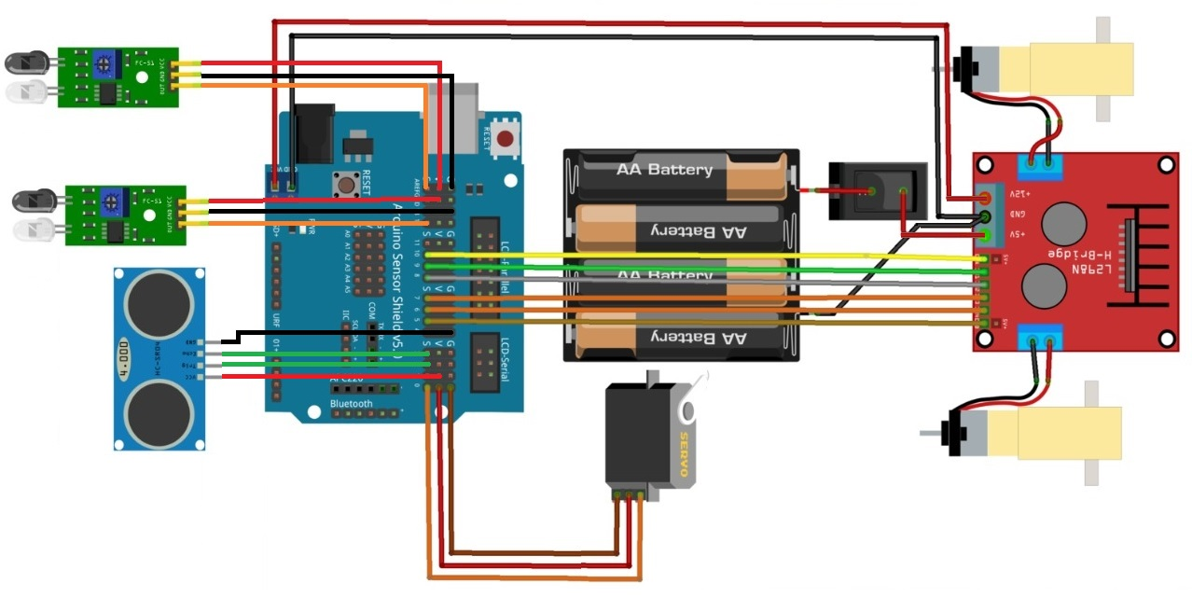
CIRCUIT DIAGRAM

Slide 9
How it’s following the line
A B C
2 IR sensors
A. Both IR LEDs are on the line. Robot car should move forward.
B. The Right IR LED is on the line while the left deviates to the left. Robot car should turn to the right.
C. The Left IR LED is on the line while the right deviates to the right. Robot car should turn to the left.

Slide 10
How it’s avoiding obstacles
Ultrasonic sensor
Sensor
Sound
Distance
Object
Obstacle
5 cm
The basic principle behind the working of ultrasonic sensor is to note down the time taken by sensor to transmit ultrasonic beams and receiving the ultrasonic beams after hitting the surface. Then further the distance is calculated.

Slide 11
ISSUES
WE DID NOT HAVE SOME TOOLS AND SENSORS
0 PREVIOUS KNOWLEDGE ABOUT ARDUINO
NOT WORKING SENSORS.

Slide 12
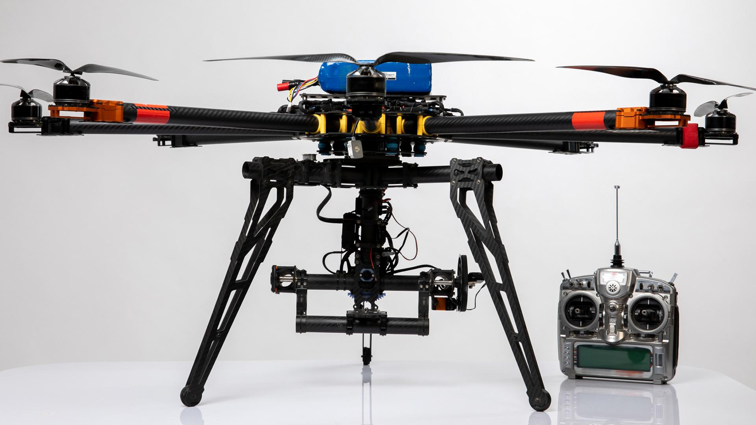
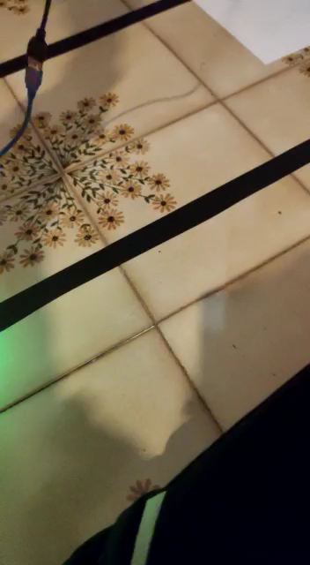
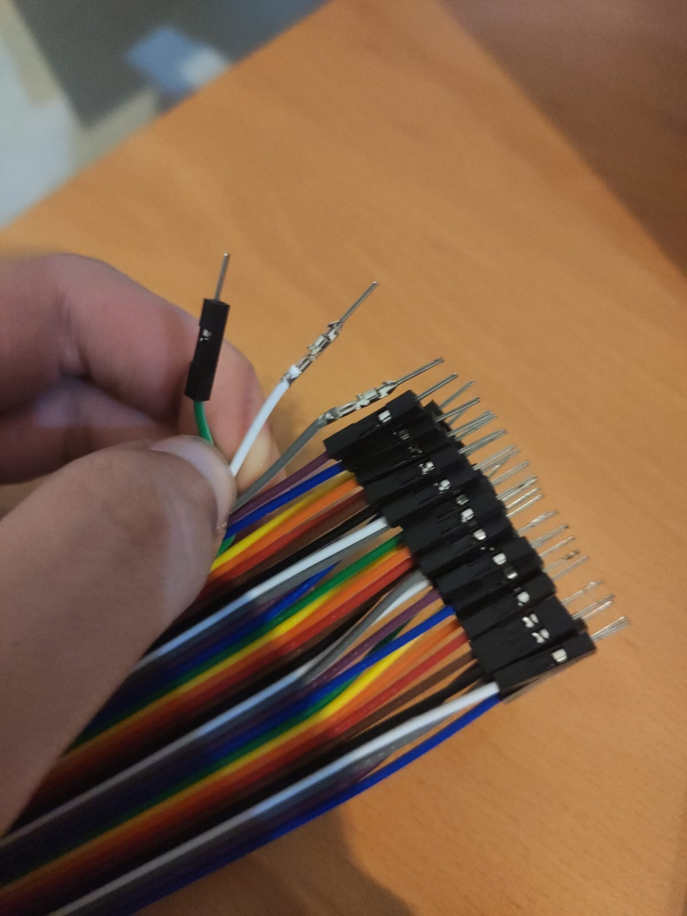
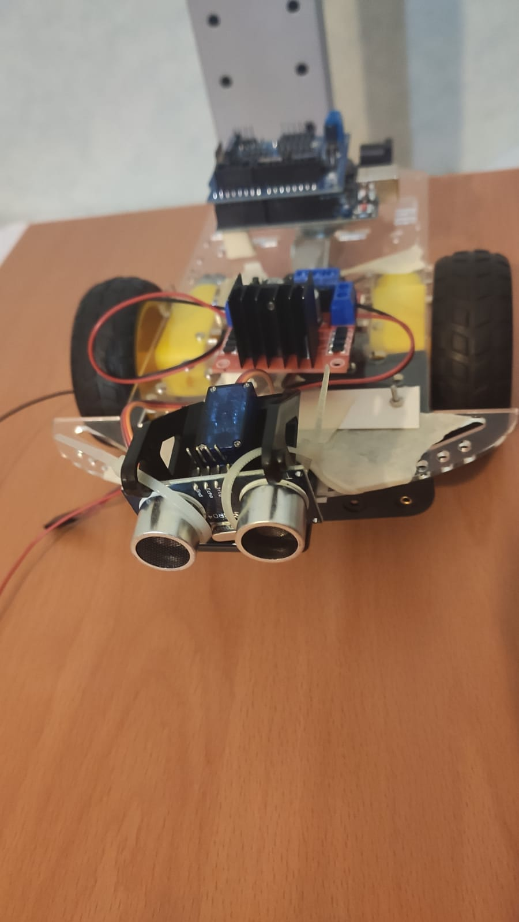
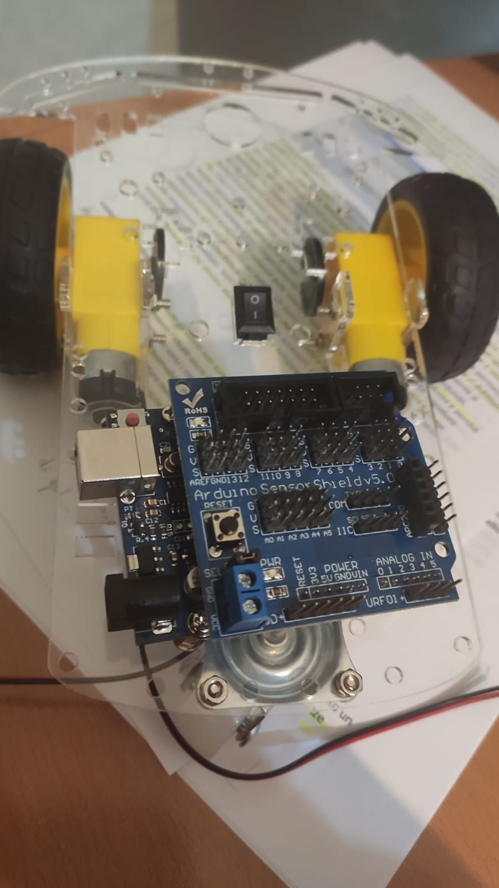
A PICTURE IS WORTH A THOUSAND WORDS

Slide 13
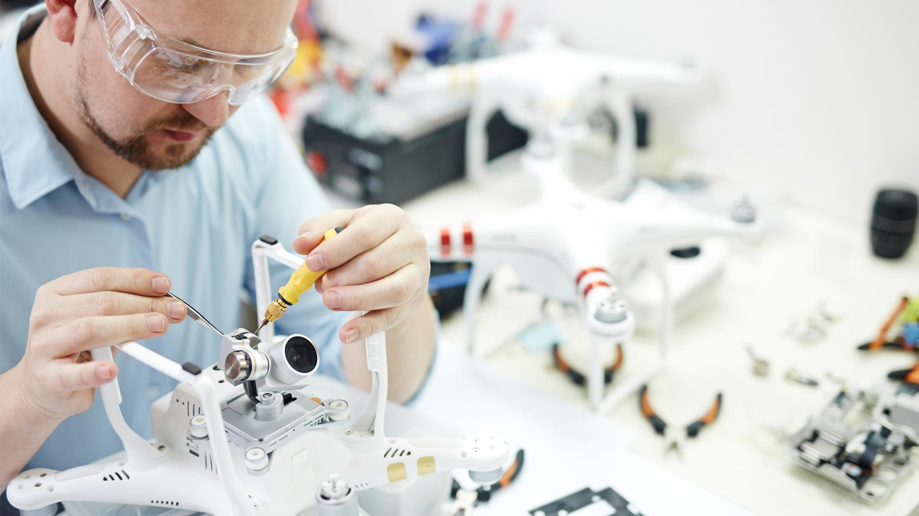
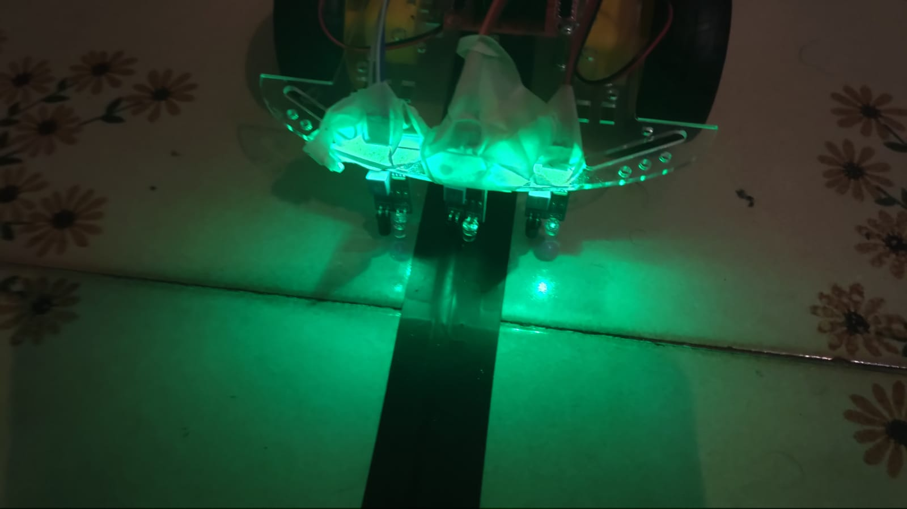
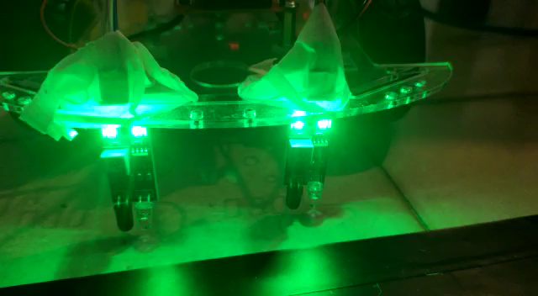
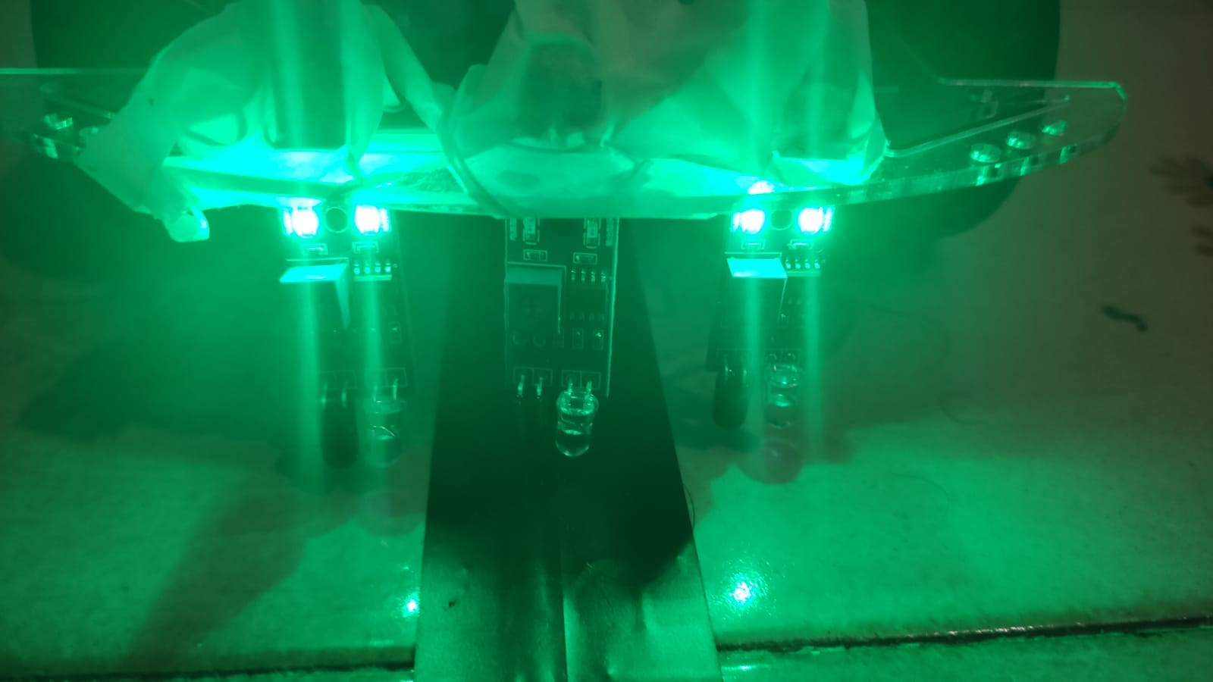
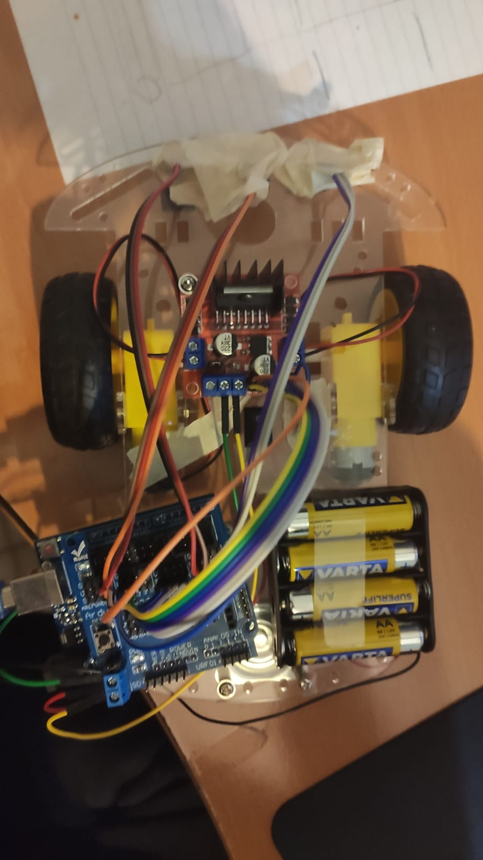
A PICTURE ALWAYS REINFORCES THE CONCEPT

Slide 14
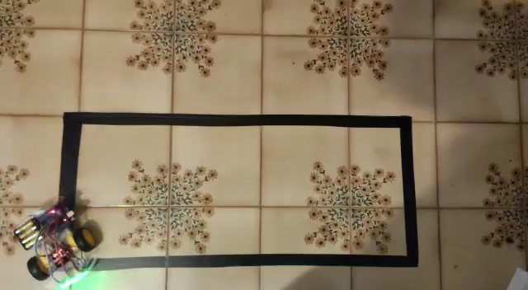
LINE FOLLOWING

Slide 15
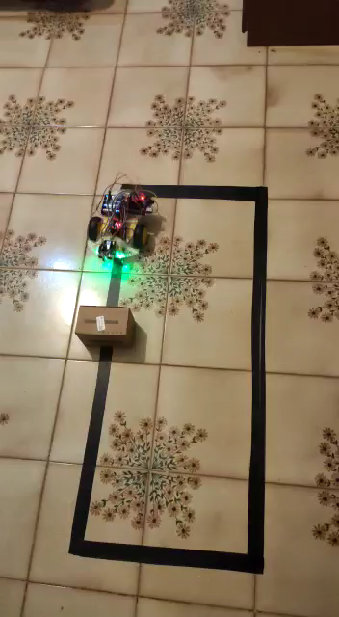
SMALL OBSTACLE

Slide 16
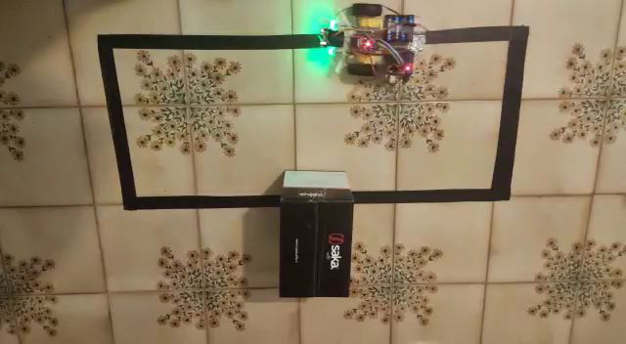
BIGGER OBSTACLE

Slide 17
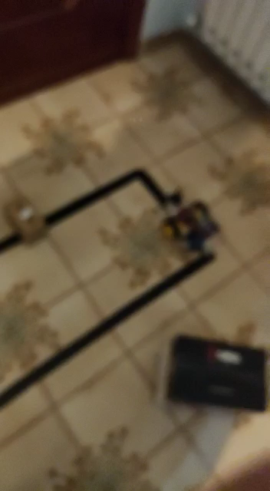
TWO OBSTACLES

Slide 18

THANK YOU FOR YOUR ATTENTION!

